Slide 1
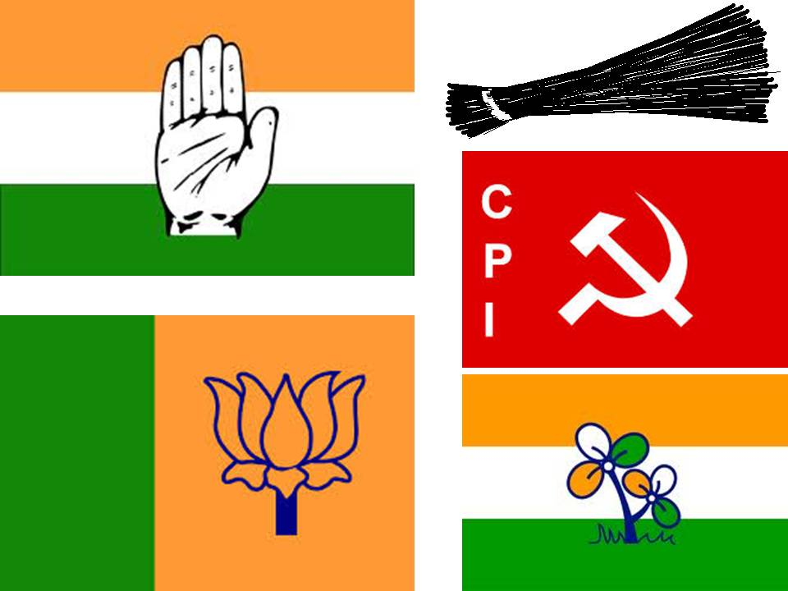
CH-5 POLITICAL PARTIES

Slide 4
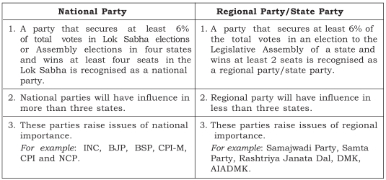

Slide 8
PREPARED BY
KALYANI S
SNS ACADEMY

